Slide 1
Applications of Evolutionary / nature-inspired algorithms in Computer vision
Farid Ghareh Mohammadi
Ph.D Student in Computer Science Department
University of Georgia
Farid.ghm@uga.edu

Slide 2
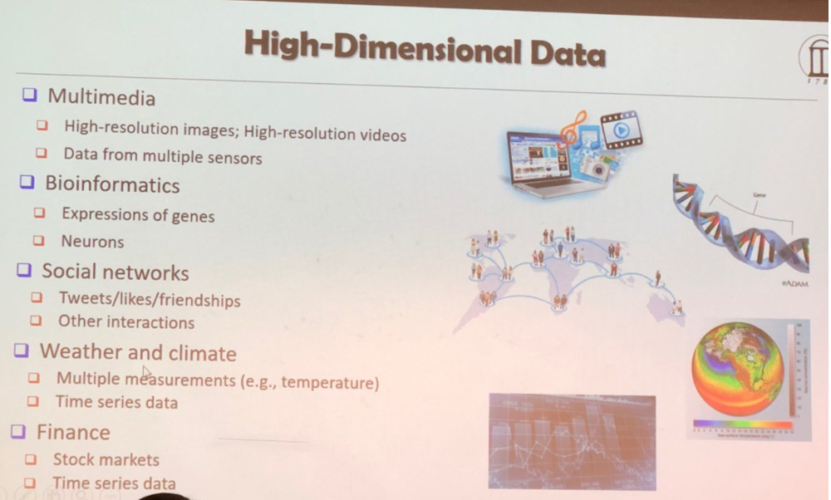
Emerging problems:
High dimensionality problem
AKA:
Curse of Dimensionality (CoD) : too much information!

Slide 3
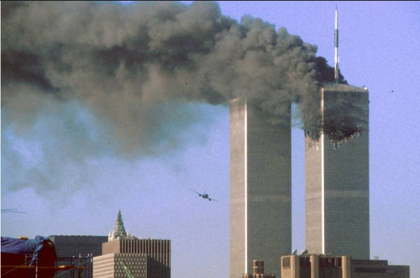
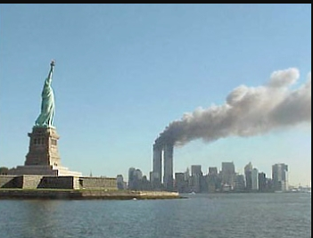
Steganography Started getting smarter …
September 11 2001
Steganalysis Started getting important

Slide 4
Outlines:
Review Where you are
Summary
Image Processing : Image classification
Steganography VS Steganalysis
Evolutionary schema

Slide 5

Introduction to Image Proceesing
The world of Computer Technology
Software
Hardware
Image processing
Robotics
Machine Learning
Medical Imaging
Image Forensic
Steganography & Steganalysis
Data Mining
Advances in DM
Advances in SE
Artificial Intelligence

Slide 6

Very Quick Shot
Art of embedding messages
Art of detecting the hidden Messages
Steganography
Steganalysis

Slide 7

Image processing Basic procedure of a specific Technique
Image Evaluation
Image Acquisition
Image Classification
Image Preprocessing
Image Processing : Image classification

Slide 8
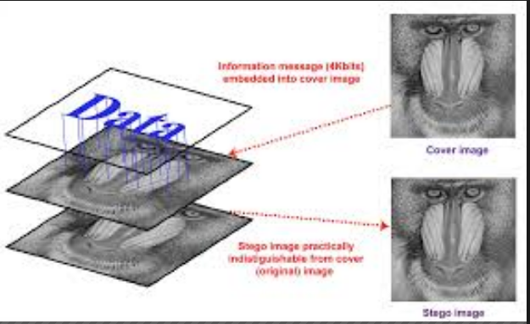
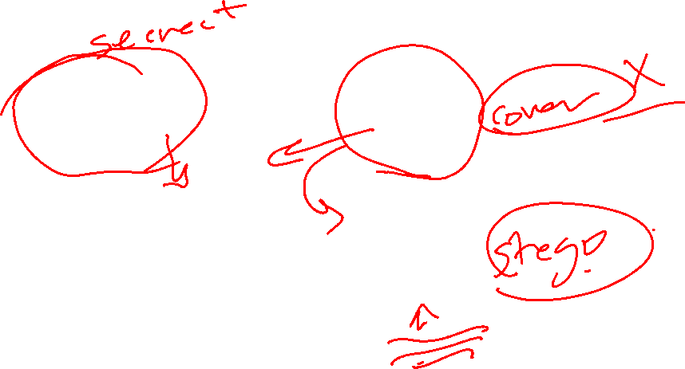
Image Processing Steganography VS Steganalysis

Slide 9
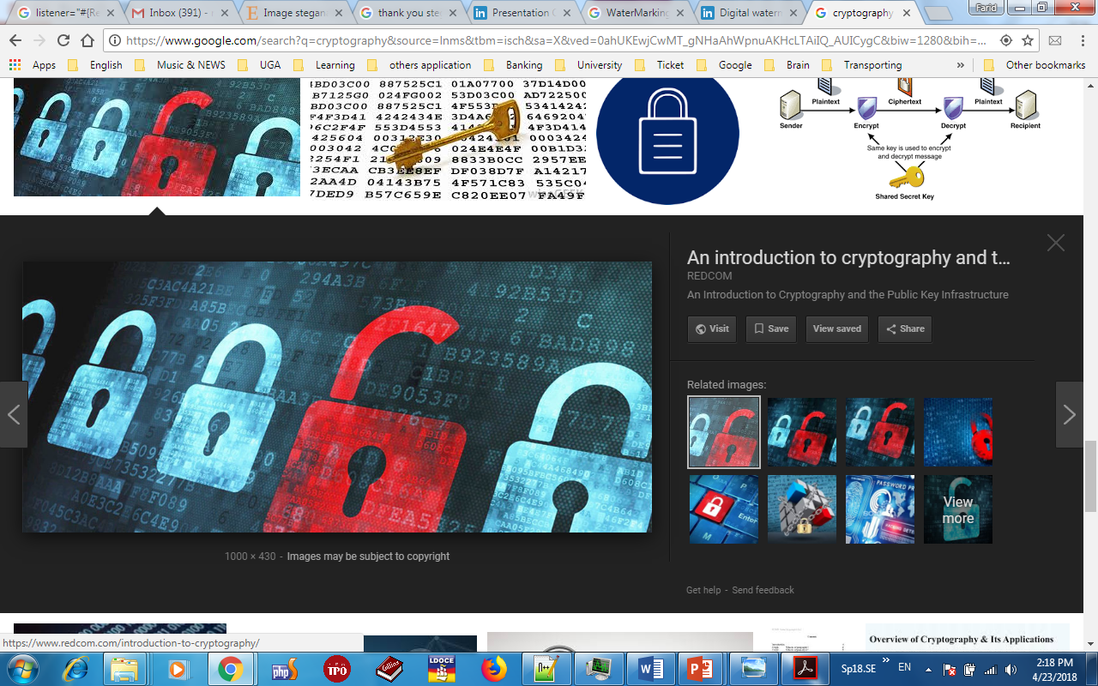
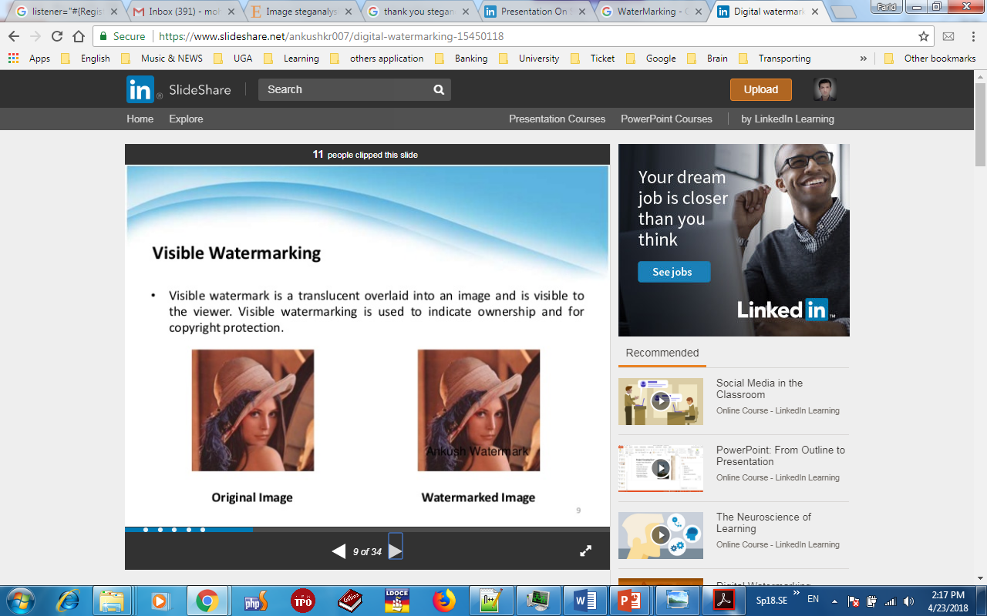

Steganography In comparison with others
WaterMarking
Cryptography
Steganography

Slide 10



Stego VS Cover
Notes:
PSNR // threshold for embedding =0.7

Slide 11
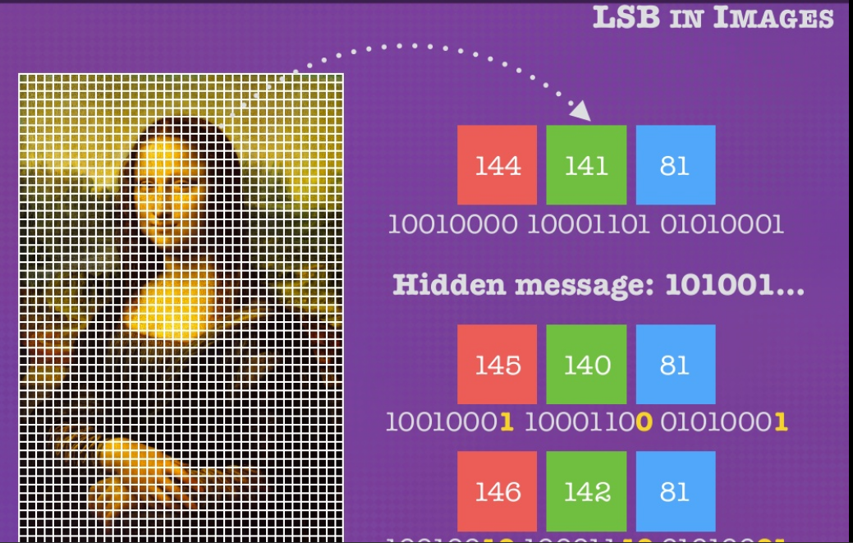
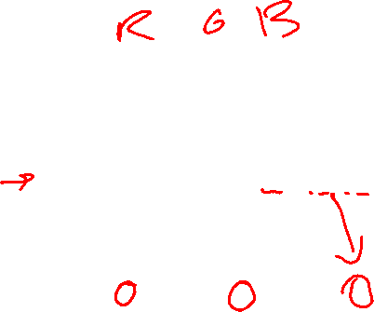
Image Processing Steganography VS Steganalysis
One Channel Image
Triple Channel Image
RGB
HSV
Binary
Gray
(0-255)

Slide 12
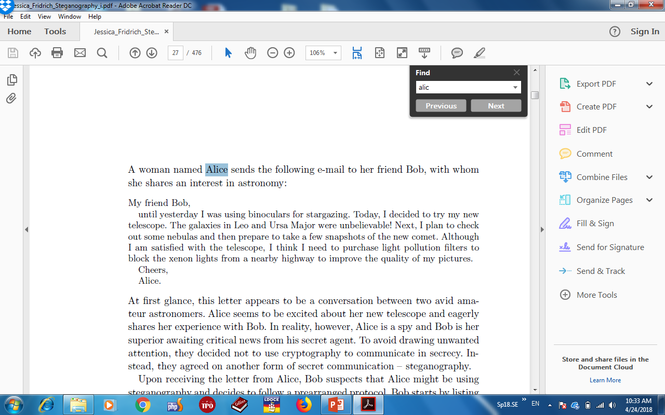
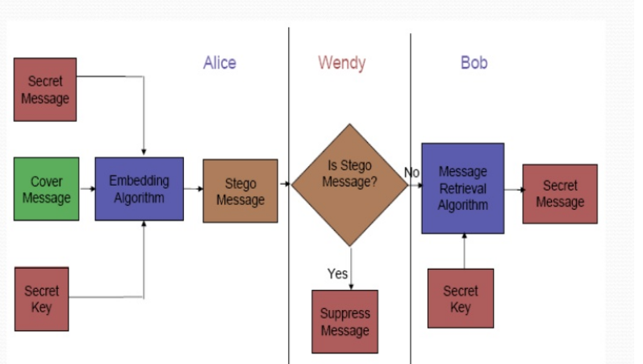
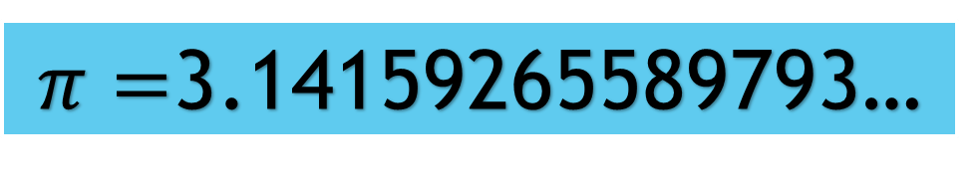
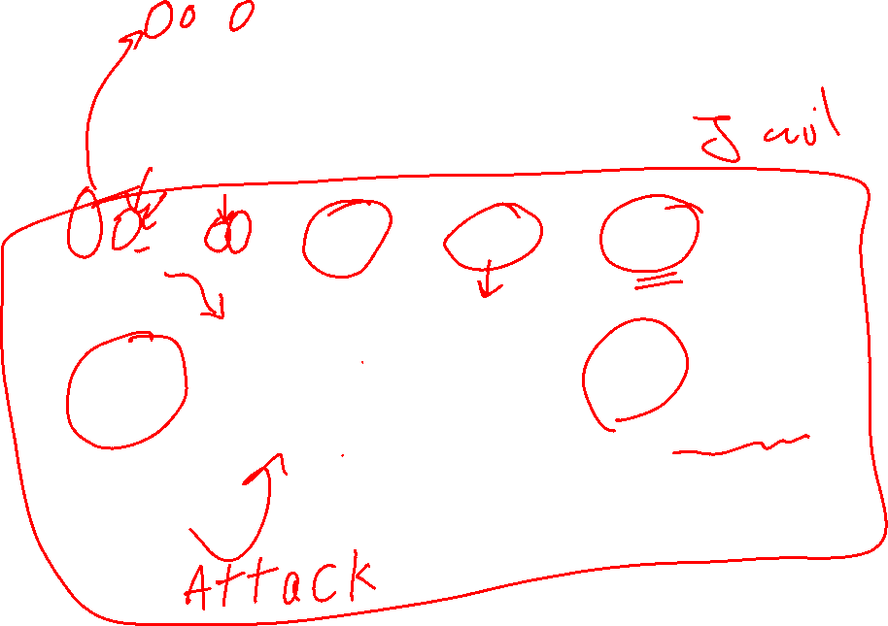
General Overview Steganography VS Steganalysis
MfBuyIwubfsTIdttmntTgiLaUMwuNIptcosnatpttafs
otcAIaswttItIntplpftbtxlfanhtitqompCA
$π=$3.14159265589793…
Clear?
Buubdlupnpsspx
Attack Tomorrow

Slide 13
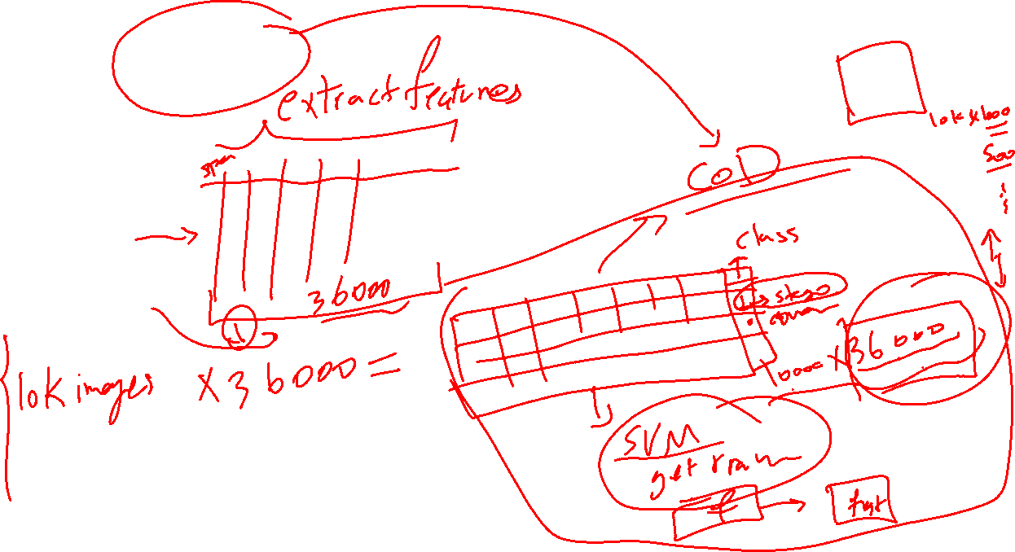
Why EA / NIA?

Slide 14
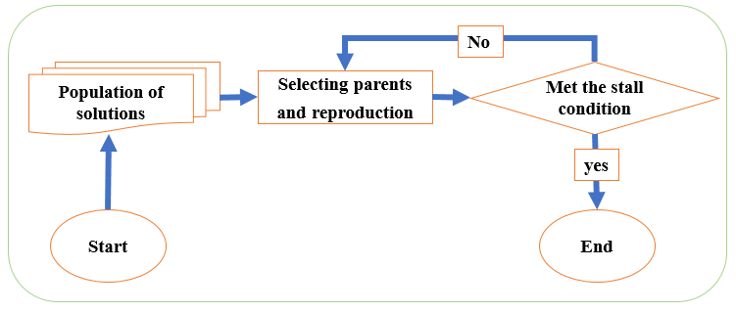

General procedure of Evolutionary/Nature-inspired algorithm

Slide 15
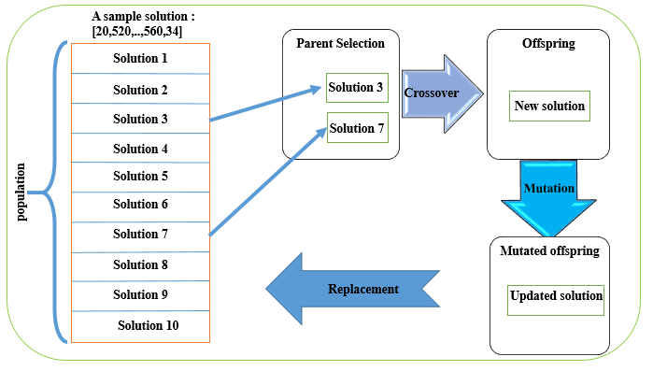
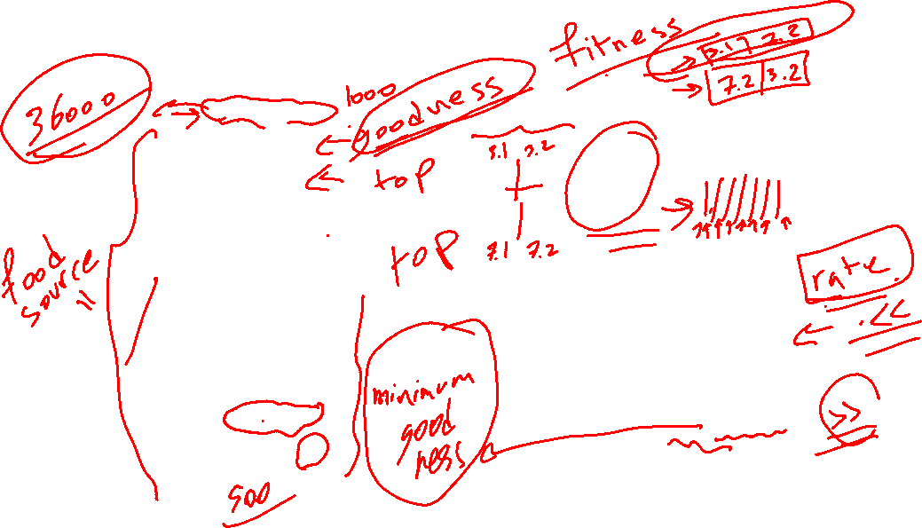
General procedure of Evolutionary/Nature-inspired algorithm

Slide 16
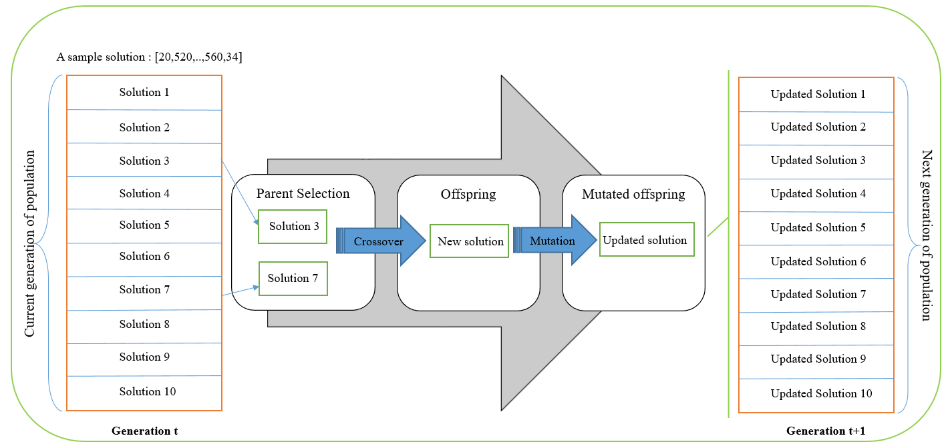
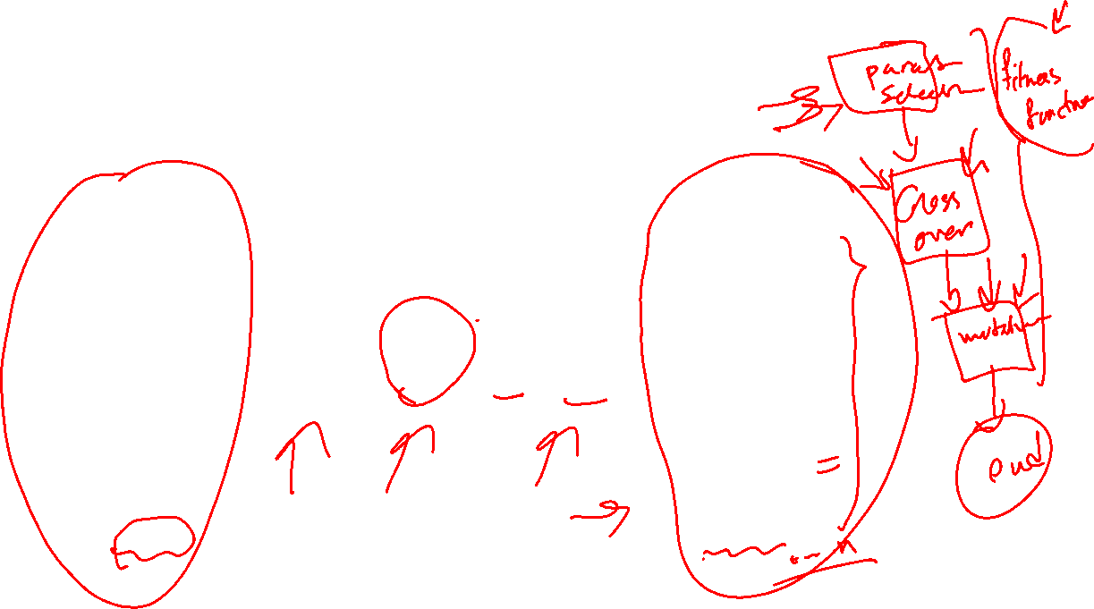
General procedure of Evolutionary/Nature-inspired algorithm

Slide 17
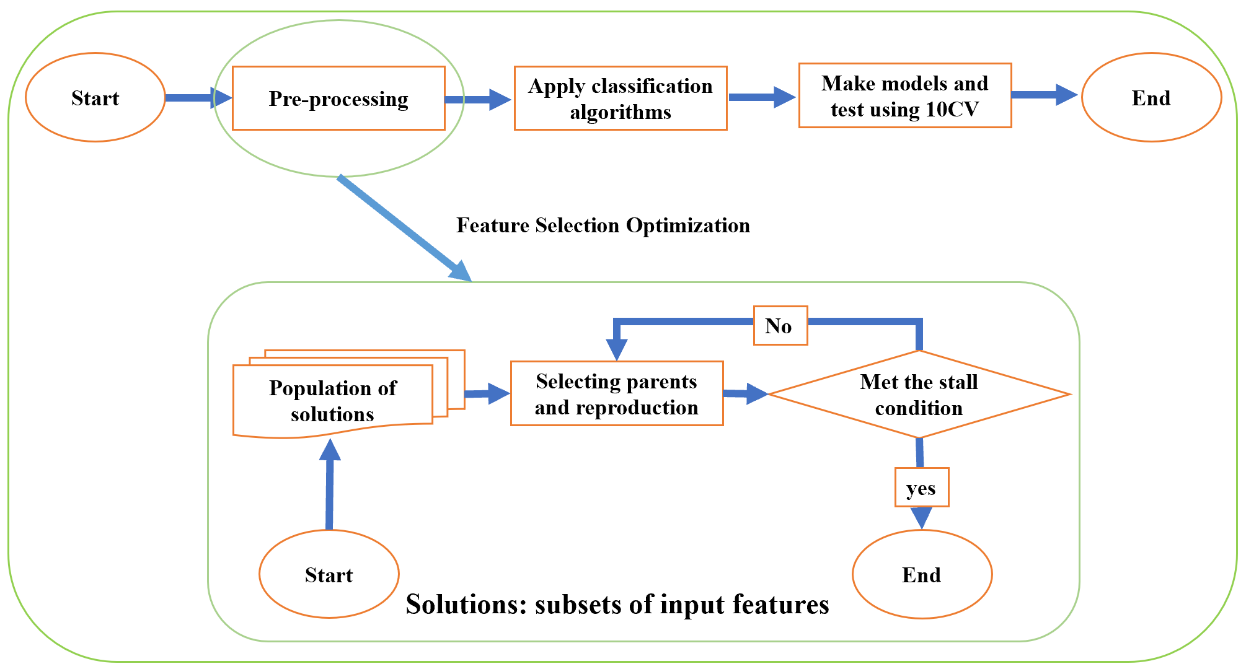
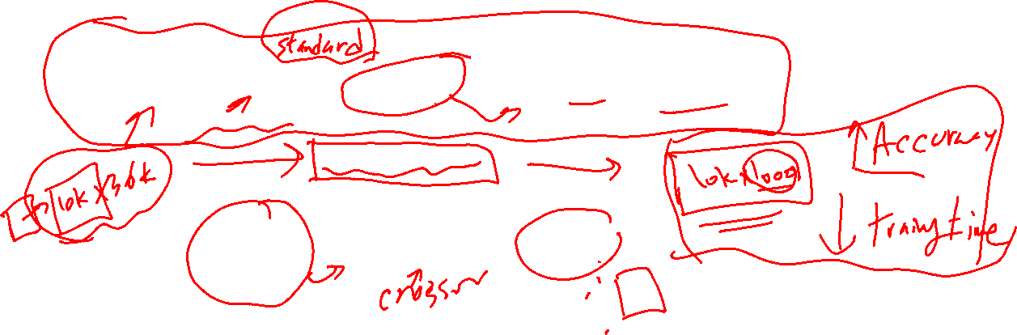
General procedure of Evolutionary/Nature-inspired algorithm

Slide 18
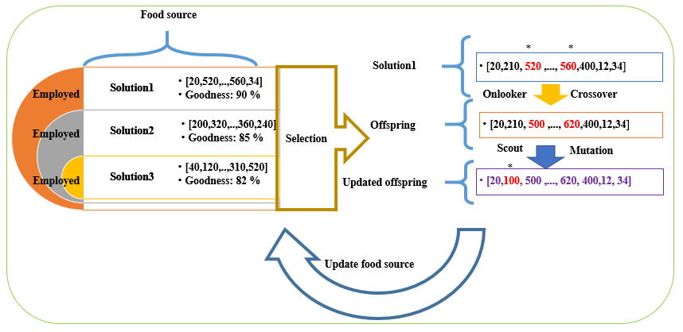
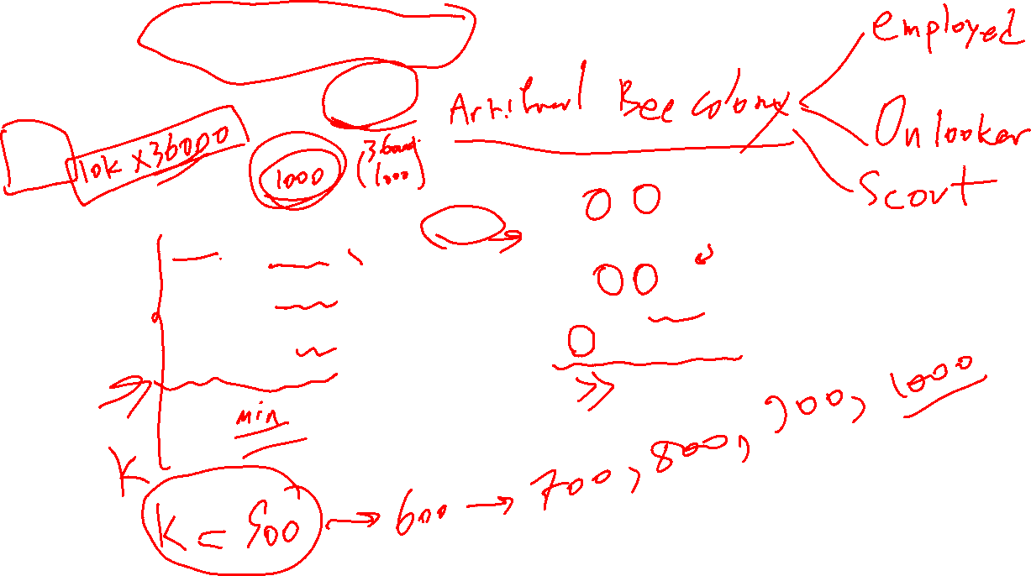
IFAB : Image steganalysis using feature selection-based ABC

Slide 19
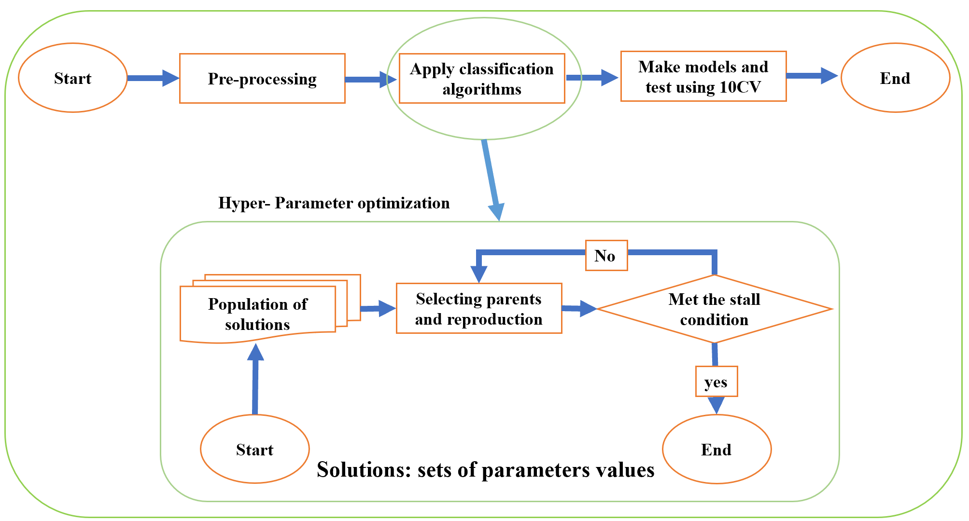
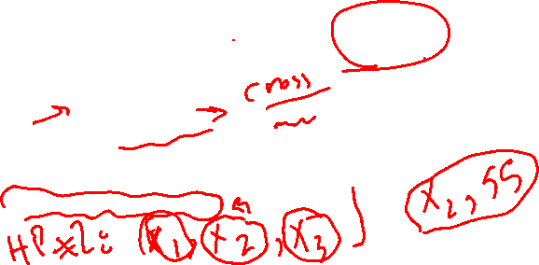
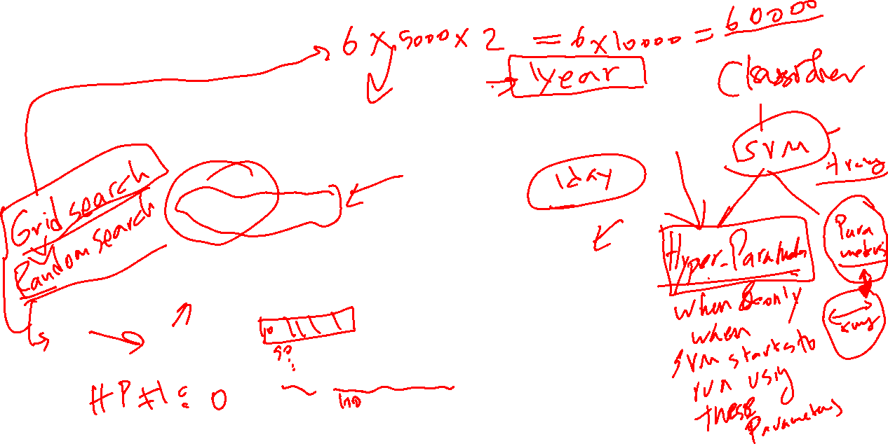
General procedure of Evolutionary/Nature-inspired algorithm

Slide 20
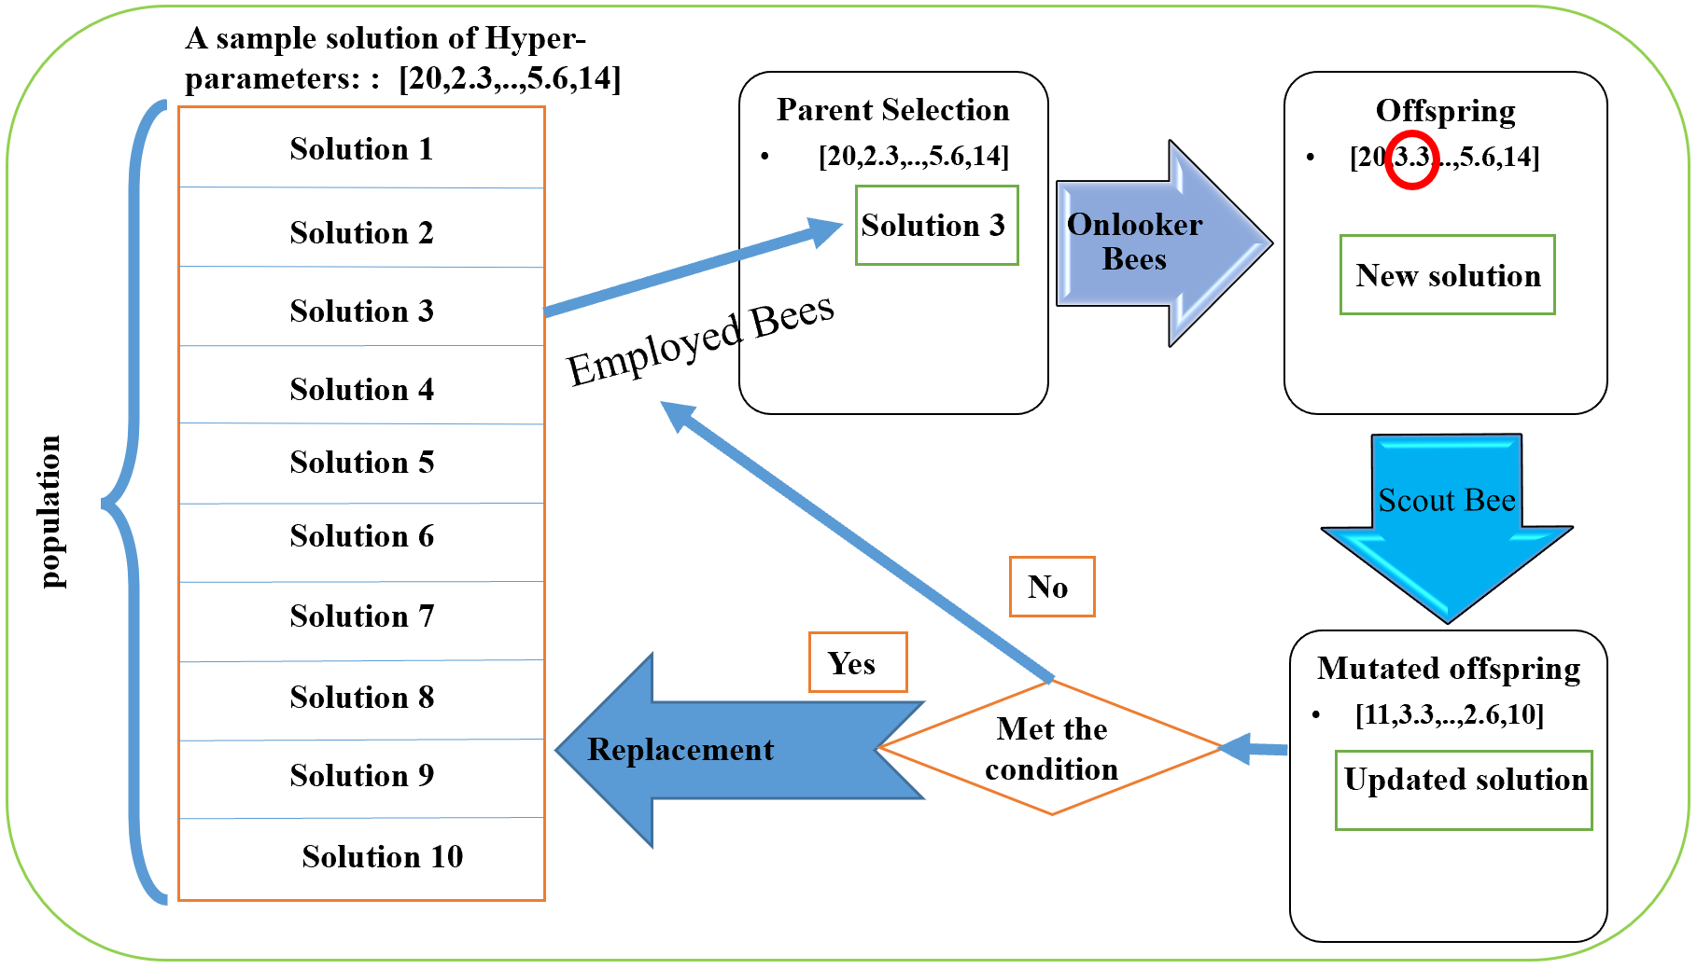

General procedure of Evolutionary/Nature-inspired algorithm

Slide 21
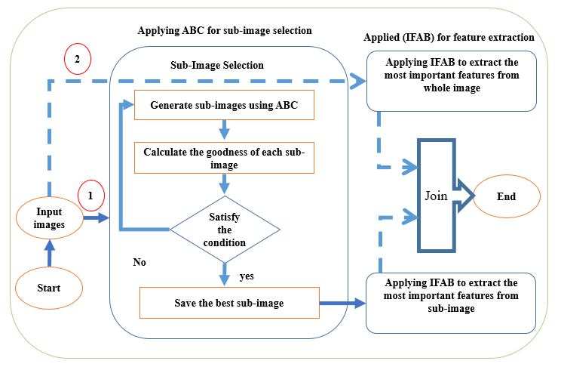
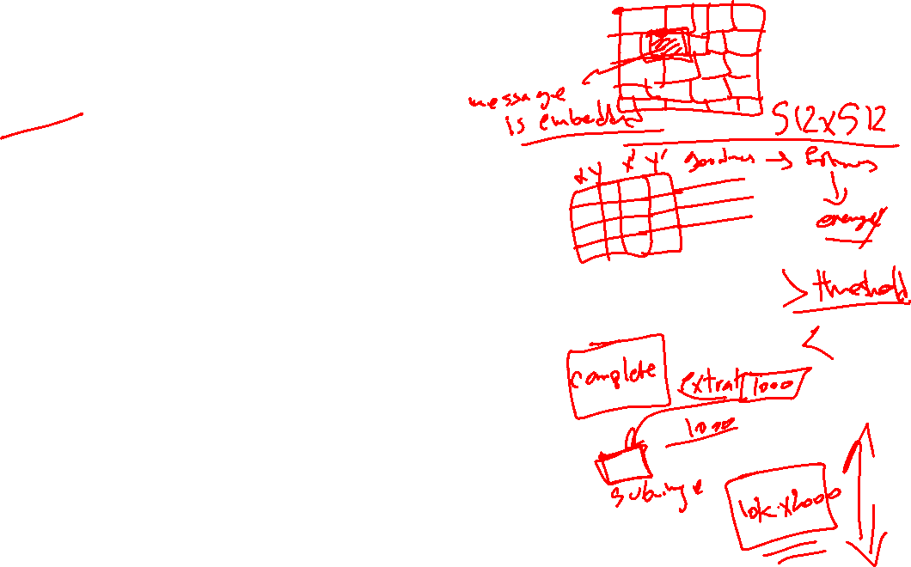
RISAB: Region-based Image Steganalsis using ABC

Slide 22
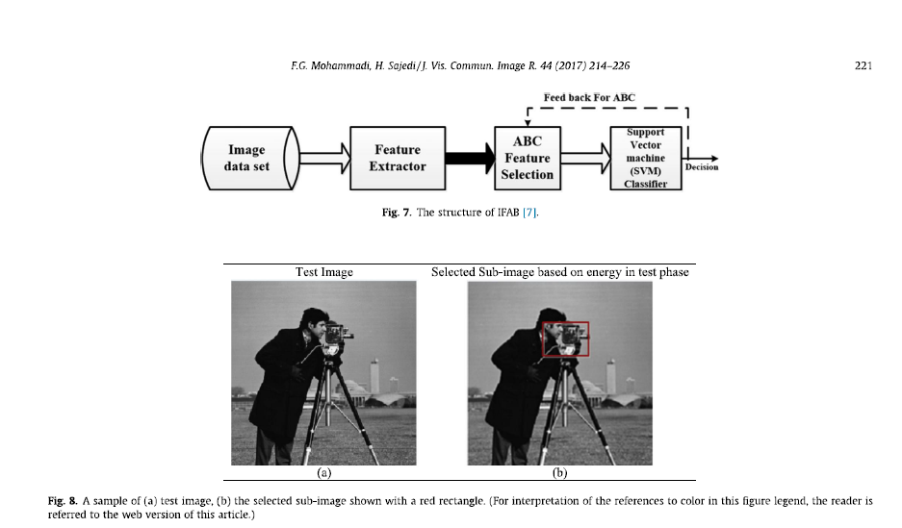
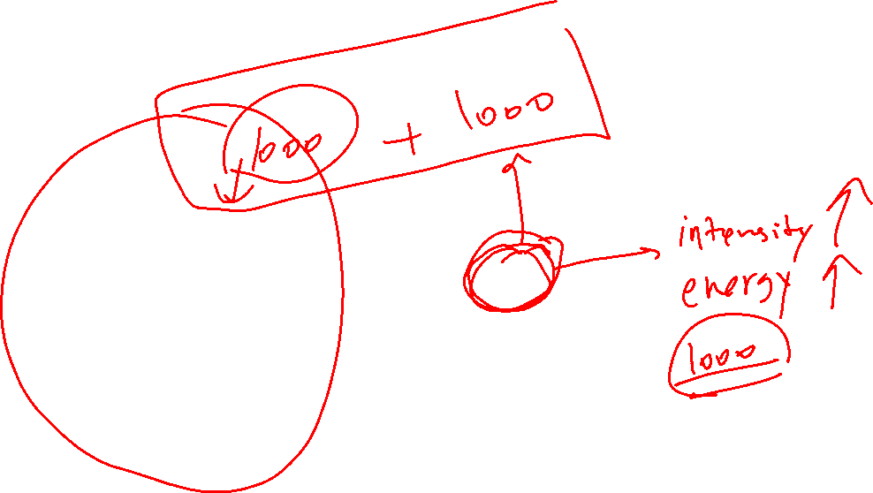
RISAB-example

Slide 23
References:
Thank you
http://ice.dlut.edu.cn/LiMing/research.html
https://doi.org/10.1016/j.jvcir.2016.12.003
https://www.redcom.com/introduction-to-cryptography/
https://www.slideshare.net/ankushkr007/digital-watermarking-15450118
Steganography in Digital Media,Principles, Algorithms, and Applications By Dr Jessica Fridrich

